Slide 1

Modelling the 2019 Election
Ben Newey
Department of Philosophy, University of Warwick

Slide 2
Motivation
Elections are uncertain and significant
Polling is bad at predicting results because:
Extrapolation errors
Imperfect seat mapping – plurality rule
Poll results diverge – which are right?
Notes:
Geopolitical stability etc

Slide 3
Existing election models
Demographic predictors
Multilevel Regression and Post-stratification (MRP) models
YouGov
Electoral Calculus

Slide 4
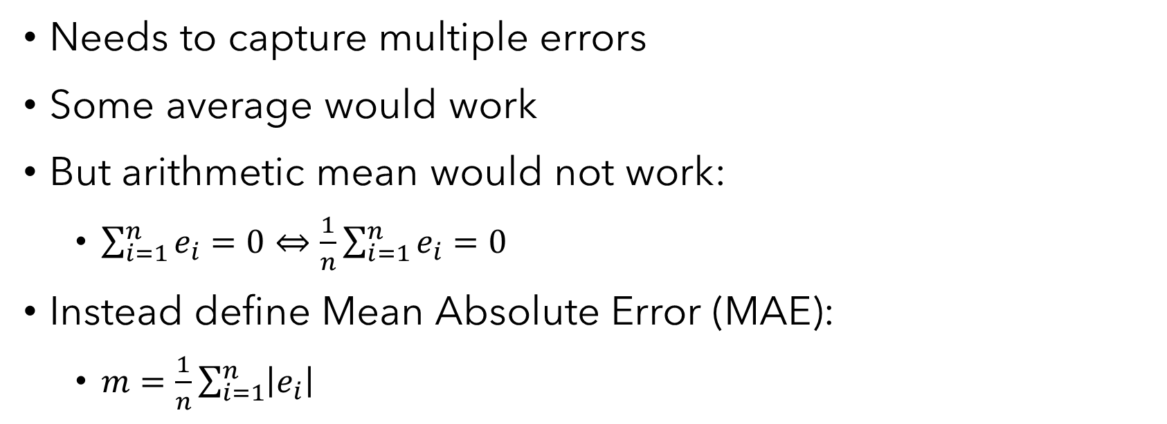
Choosing a metric
Needs to capture multiple errors
Some average would work
But arithmetic mean would not work:
$\sum_{i=1}^{n}{e_{i}}=0⇔\frac{1}{n}\sum_{i=1}^{n}{e_{i}}=0$
Instead define Mean Absolute Error (MAE):
$m=\frac{1}{n}\sum_{i=1}^{n}{\left|e_{i}\right|}$

Slide 5
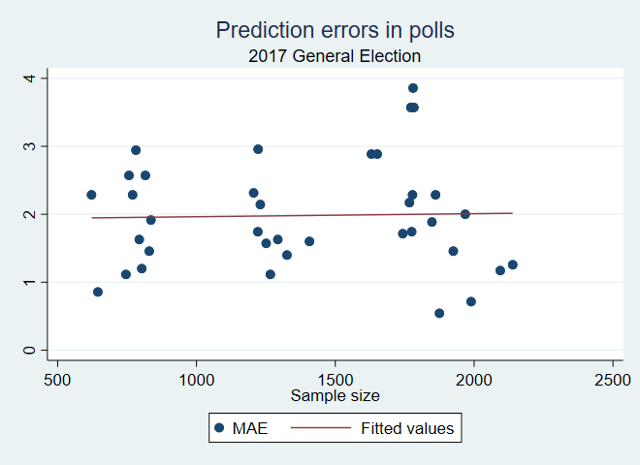
Predictors of polling accuracy
Some things don’t have an effect in some years…

Slide 6
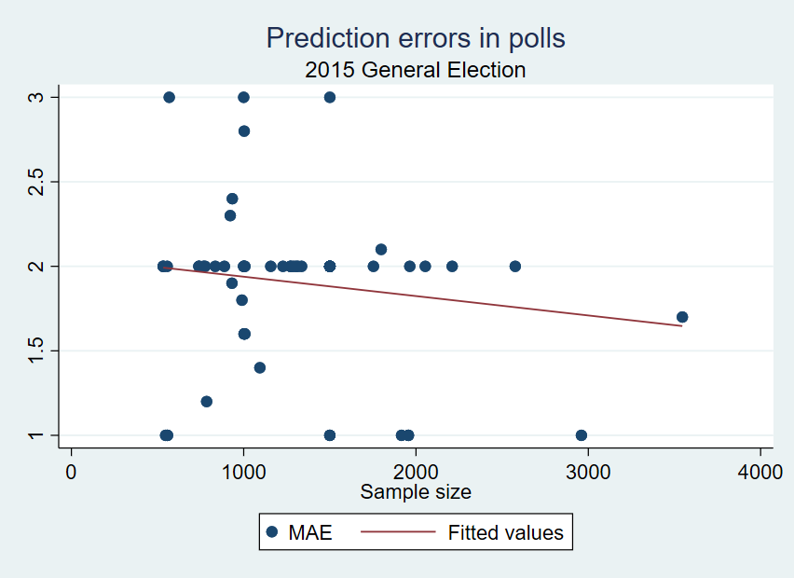
Predictors of polling accuracy
…but sometimes they do

Slide 7
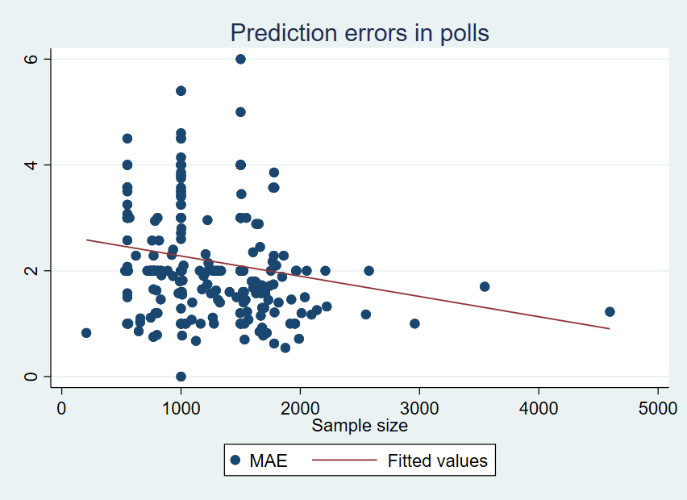
Static assumptions

Slide 8
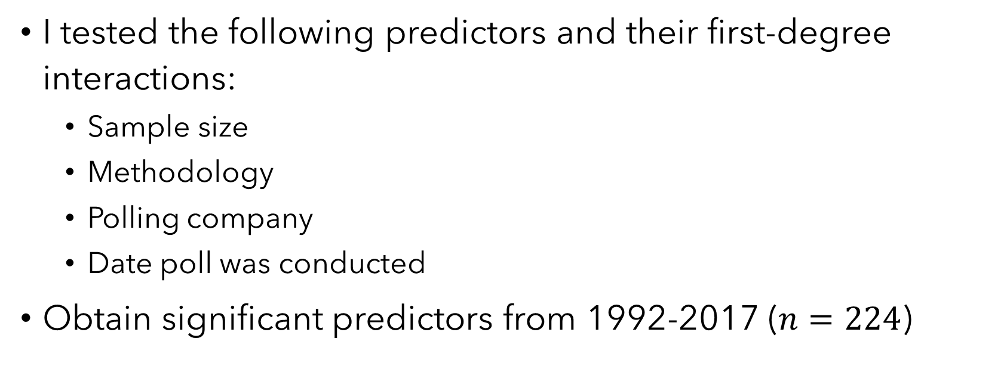
Predictors of polling accuracy
I tested the following predictors and their first-degree interactions:
Sample size
Methodology
Polling company
Date poll was conducted
Obtain significant predictors from 1992-2017 ($n=224$)

Slide 9
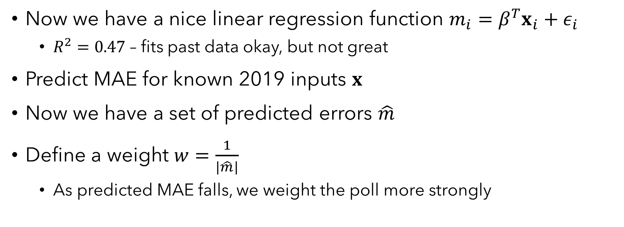
Weighting
Now we have a nice linear regression function $m_{i}=β^{T}x_{i}+ε_{i}$
$R^{2}=0.47$ – fits past data okay, but not great
Predict MAE for known 2019 inputs $x$
Now we have a set of predicted errors $\hat{m}$
Define a weight $w=\frac{1}{|\hat{m}|}$
As predicted MAE falls, we weight the poll more strongly

Slide 10
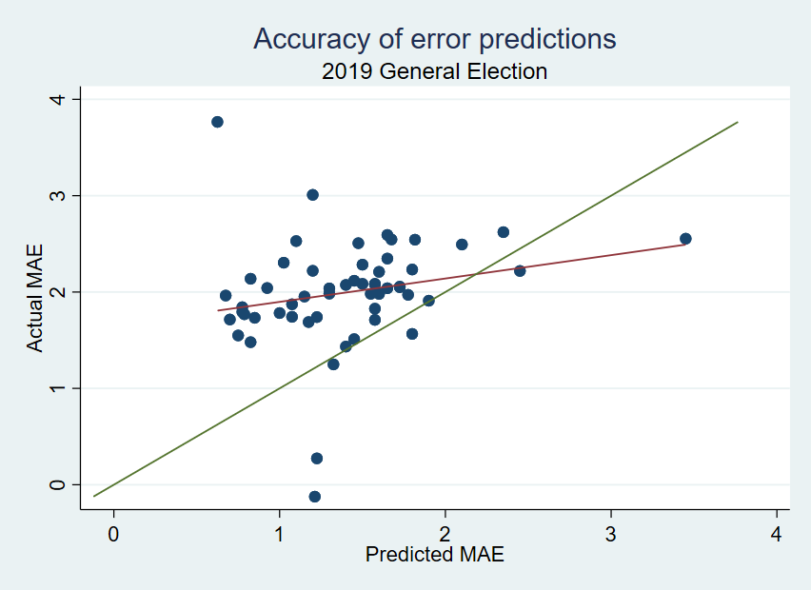
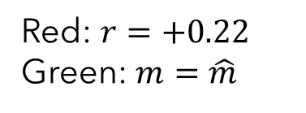
How well did the regression predict error?
Red: $r=+0.22$
Green: $m=\hat{m}$

Slide 11
Predicting vote share
Calculate a weighted average of these polls
How well did it work?

Slide 12
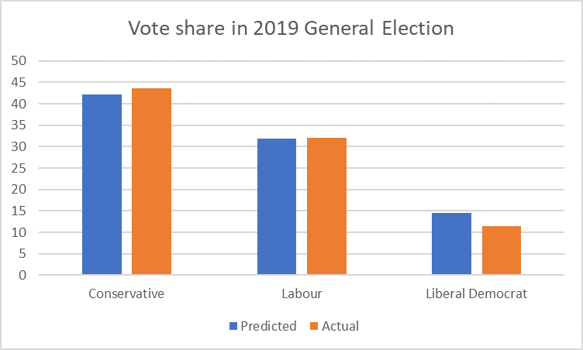
Accuracy of vote prediction

Slide 13
Predicting seats
Uniform National Swing
Simulation
Baseline
One party’s share linearly dependent
Random shocks – dependent or independent?

Slide 14
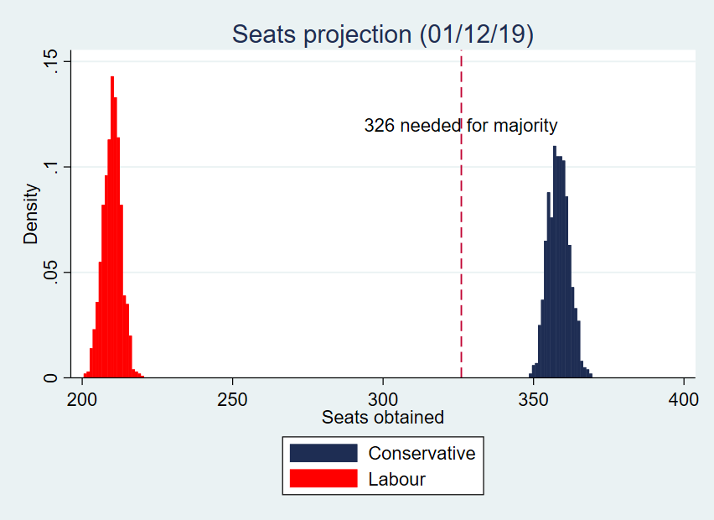
Independent shocks

Slide 15
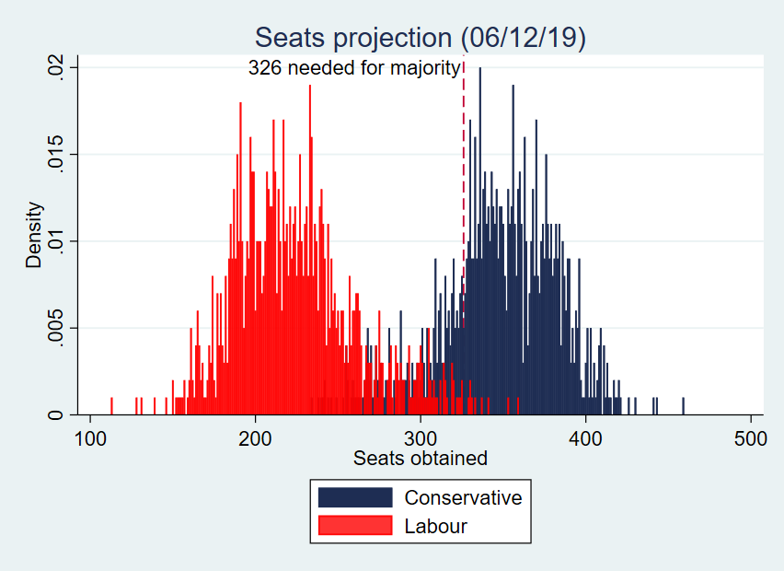
Dependent shocks

Slide 16
Probabilistic forecasting
Like the weather, we want to forecast probabilistically
Probability of Conservative majority = 77.6%
Probability of Labour majority = 0.3%
Probability of Conservative plurality = 93.6%

Slide 17
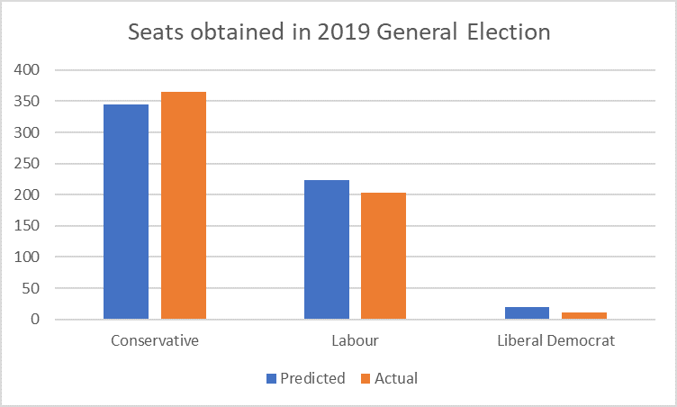
How good was the forecast?

Slide 18
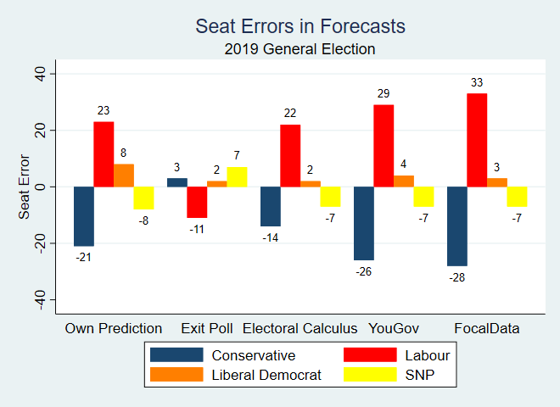
Comparison with other predictive models

Slide 19
Why did it work?
Polls were accurate
Constituency errors mitigated
650 constituencies
1000 simulations

Slide 20
Model flaws
UNS assumption didn’t hold
Static assumption needs testing
Predicted errors poor fit for data

Slide 21
Adaptation
Majoritarian election systems
2020 Presidential Elections
Adapting to dynamic model
Indirect forecasting outside elections
Polls as signals
Constituency predictions

Slide 22
Questions?

